Slide 1


Customer Success in Salesforce
Independent Project: Use Salesforce to Support Customers
Basanta Gurung

Slide 2
Project
Overview
1
Task 1: Create New Cases
2
Task 2: Create a Knowledge Base
3
Task 3: Create Knowledge Articles
4
Task 4: Business Case Analysis

Slide 3
Task 1: Create New Cases
Insert a screenshot of each of the 3 new cases you’ve just created. Make sure to show the Case Details and Contact Details sections in your screenshot so that the Subject, Description, Status, Priority, and associated Contact are all visible.
Step 1: The new case you created for Rebecca Kim.
Step 2: The new case you created for Denise Choi.
Step 3: The second new case you created for Denise Choi.

Slide 4
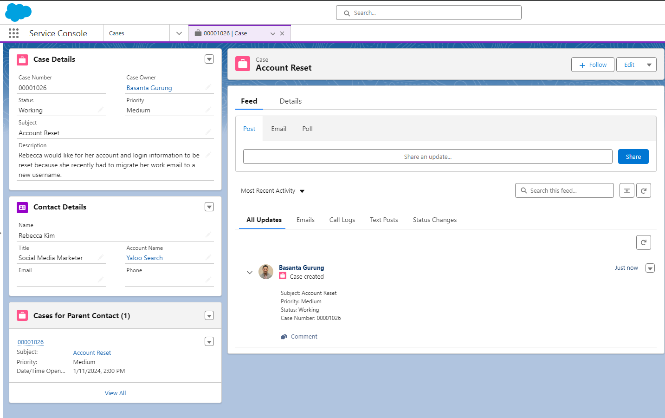
Task 1: Create New Cases
Rebecca’s Case
Insert Task 1 Step 1 Screenshot here.

Slide 5
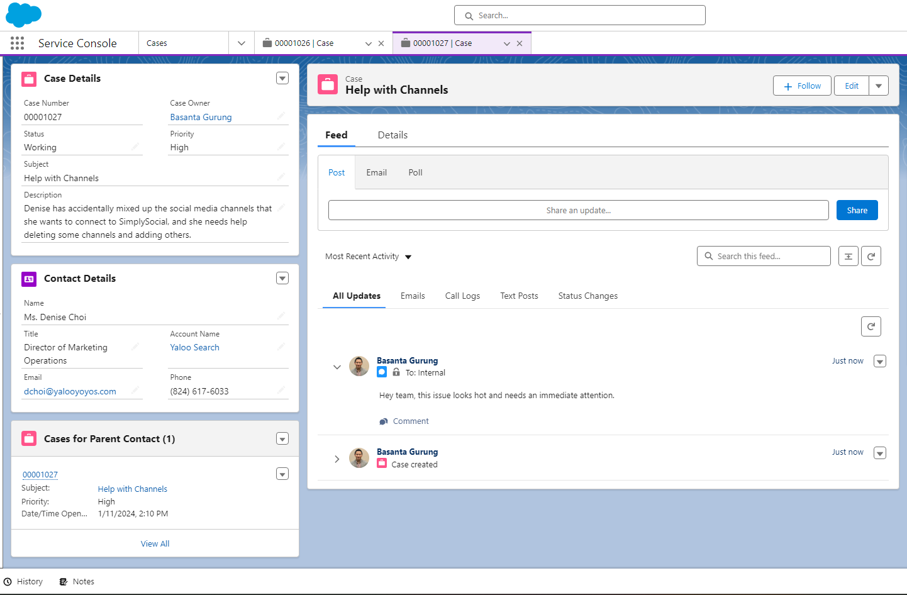
Task 1: Create New Cases
Insert Task 1 Step 2 Screenshot here.
Denise First High Priority Case

Slide 6
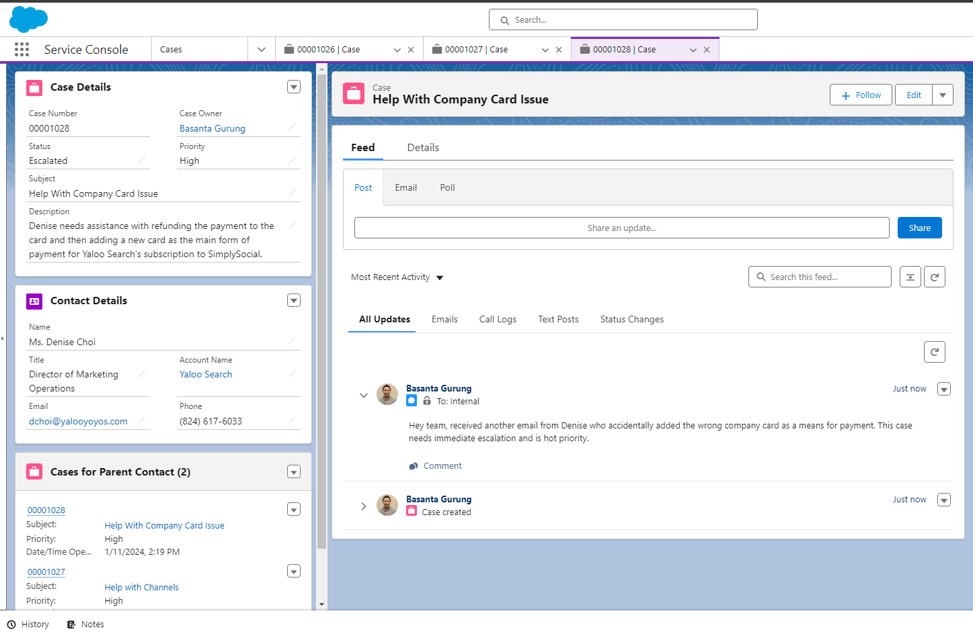
Task 1: Create New Cases
Denise Second Escalate High Priority Case
Insert Task 1 Step 3 Screenshot here.

Slide 7
Task 2: Create a Knowledge Base
Insert a screenshot of the Knowledge Base you created showing the data category group and the data categories within it.

Slide 8
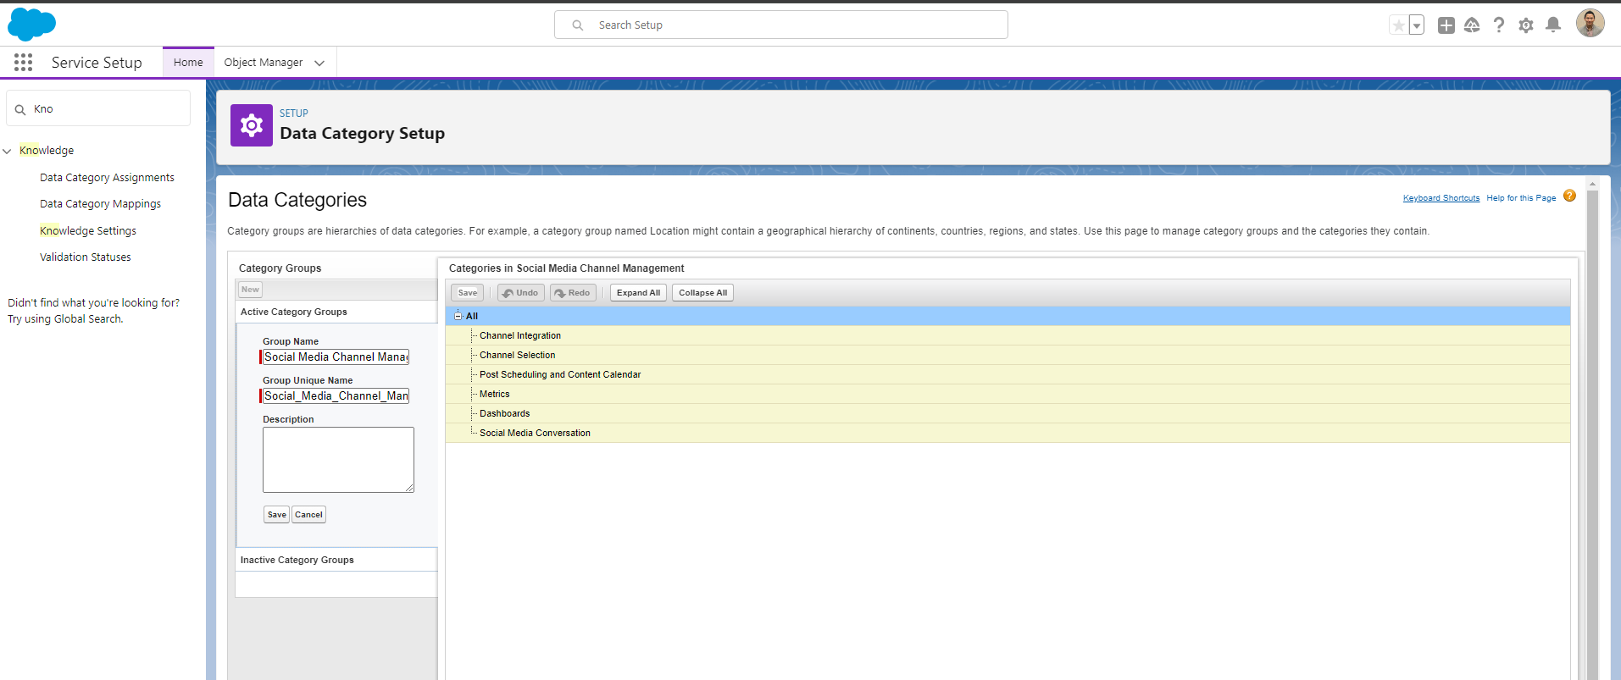
Task 2: Create a Knowledge Base
Knowledge Base for Yaloo Search
Insert Task 2 screenshot here.

Slide 9
Task 3: Create Knowledge Articles
Insert a screenshot on the following slide of the “Published Articles” list view showing you have created and published the six specified articles. Note that you may have to refresh your page for them all to appear in this list view.

Slide 10
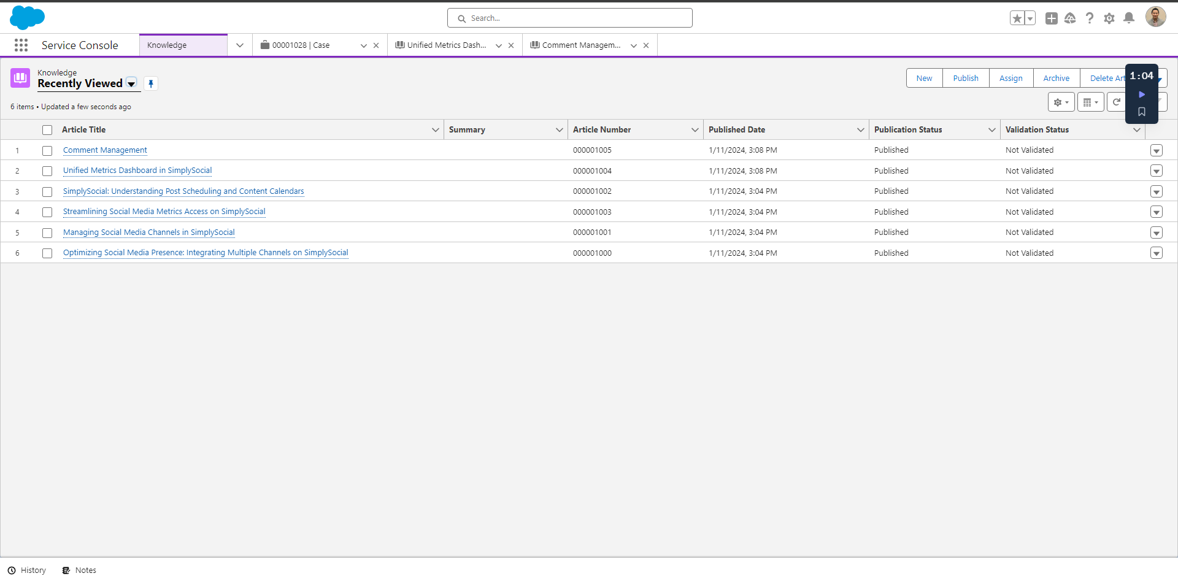
Task 3: Create Knowledge Articles
Knowledge Article
Insert Task 3 screenshot here.

Slide 11
Task 4: Business Case Analysis
In a short paragraph, describe how creating cases and knowledge base articles in Salesforce helps SimplySocial more efficiently and effectively support their customers. In your description, include:
The overall purpose of cases and knowledge bases
The major steps you took to create cases and a knowledge base
How SimplySocial benefits from using cases and knowledge bases

Slide 12
Task 4: Business Case Analysis
Creating cases and knowledge base articles in Salesforce enhances SimplySocial's customer support by streamlining issue resolution and providing a centralized repository of information. The process involves generating cases to track and manage customer inquiries, while knowledge-base articles capture solutions and best practices. This systematic approach accelerates problem-solving for support teams and empowers users to access self-help resources, improving overall customer satisfaction and efficiency for SimplySocial.

Slide 13

You have reached the end of this Project!
This is the end of this Independent Project! Great job completing all these tasks in Salesforce. Make sure you download a copy of this deck for your portfolio.

